Slide 1
Multi-criteria optimization of budget allocation for resilience improvement of critical infrastructures exposed to natural hazards and climate change

Slide 2
2
Current features
Hazard modelling: flood events depth and duration sampled with copula and then spatially mapped onto the system topology using hazard maps.
Climate change modeling: the optimization allows selecting one specific climate scenarios or to sample one scenario in each realization (for robust agent training).
Impact computation: the environment maps sampled water depths to asset-specific fragility curves, estimates downtime via repair-time distributions (plus flood duration), and aggregates lost gas/power supply and affected population shares.
Observations (system state): current wall height for each asset and current sea level.
Actions: seven wall-height increments (0 to 3 m in 0.5 m steps) per asset. Repeated upgrades of same asset on consecutive years are cancelled and penalized.
Budget enforcement: proposed upgrades are costed with a wall cost model. If the yearly spend exceeds the budget, the most expensive increments are deleted until feasible.
Reward shaping: losses for gas vs electricity and economic vs societal impacts are combined with the dynamic weight vector for decision-maker preferences.

Slide 3
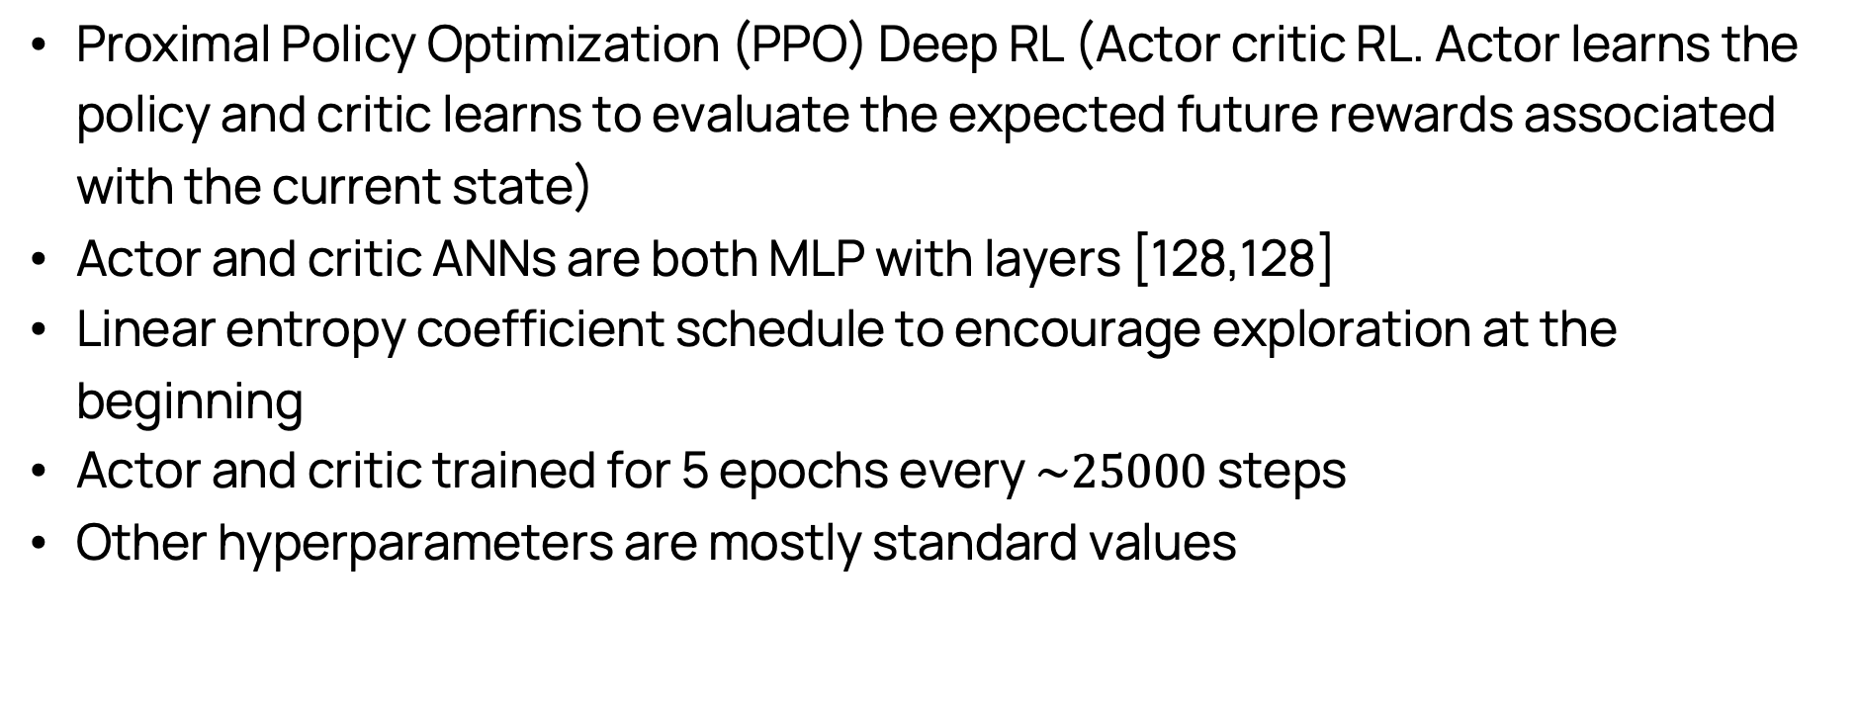
3
More technical stuff
Proximal Policy Optimization (PPO) Deep RL (Actor critic RL. Actor learns the policy and critic learns to evaluate the expected future rewards associated with the current state)
Actor and critic ANNs are both MLP with layers [128,128]
Linear entropy coefficient schedule to encourage exploration at the beginning
Actor and critic trained for 5 epochs every $\sim 25000$ steps
Other hyperparameters are mostly standard values

Slide 4
TODO list
REFINE THE CASE STUDY (deadline Friday 31/10):
Add share residential-industrial for each county - Santi
Eliminate Jefferson and add more PVs with coordinates - Thomas
Generate the hazard maps with the new coordinates - Ste
Test the environment -> 4 plots at 4 different years and see distributions of failure probabilities of each asset -> see most vulnerable assets
Test the optimization -> try with different weights and see the shifts in the policy
Deadline Wednesday 5/11

Slide 5
Possible extensions for journal
In conference paper only nodes fail (links are always safe) -> probably we have a hurricane to have such big floods -> wind fragility for electrical links (multi-hazard!) -> investments to improve the links

Slide 6
Environment test

Slide 7
Optimization test

